Slide 1
Patents 101
Jeffrey Sears, Ph.D., J.D.
Chief Patent Counsel, Columbia University
Adjunct Professor, Columbia Business School

Slide 2
What is a patent?
national legal protection for an invention
invention = solution to a real-world problem that works for its intended purpose
exclusive right to prevent others from practicing the invention for 20 years

Slide 3
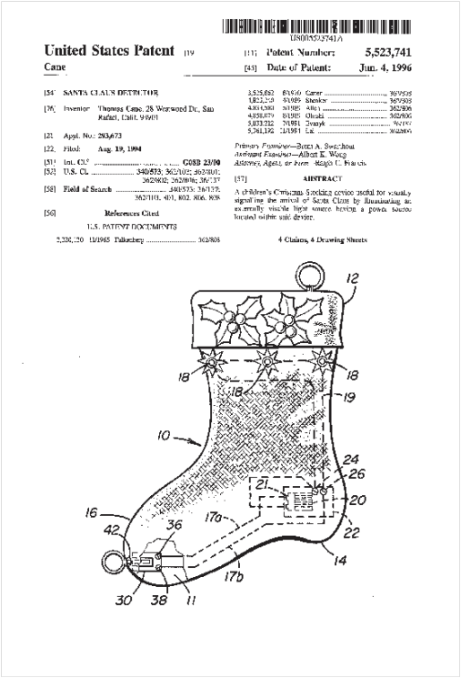
Let’s look at a real patent.
“Modern folklore includes many mystical entities, such as Santa Claus.
[I]n the minds of young children, Santa Claus’ arrival is denoted by the presence of … presents under the tree and/or … stockings filled with treats.
However, none of these customary practices … provides a … stocking which is capable of being selectively illuminated to signal the arrival of Santa Claus.”
(1/12 – 1/39.)

Slide 4
What are the parts of a patent?
Title Page
Drawings
Detailed Description
Claims
Everything Else

Slide 5
Is your invention good enough?
patentable subject matter
utility
novelty
non-obviousness

Slide 6
What are the key hurdles?
Legal
Are patent rights available?
Timing
Ownership
Business
Should you apply for them?
Money
Value

Slide 7
FAQs
Will I get a patent on my invention?
  evaluate differences between your invention (i.e., the claims) and the prior art
Are they ripping off my invention?
  evaluate differences between your invention (i.e., the claims) and their product

Slide 8
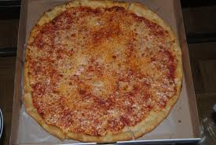
The Hypo
We all love pizza.
How do you prevent the inside of the upper lid of the pizza box from contacting the cheese, making a gooey mess?

Slide 9
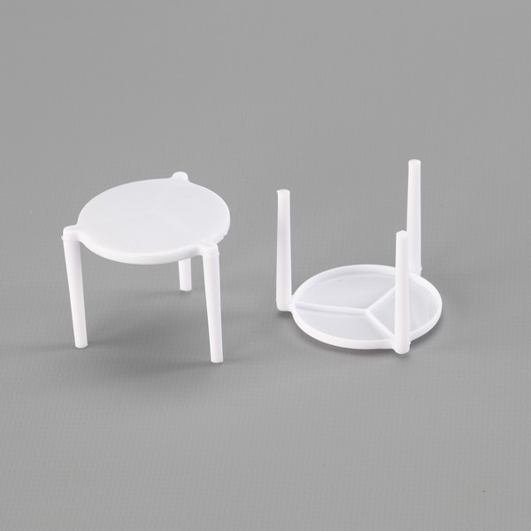
Behold the package saver! (v. 1)

Slide 10
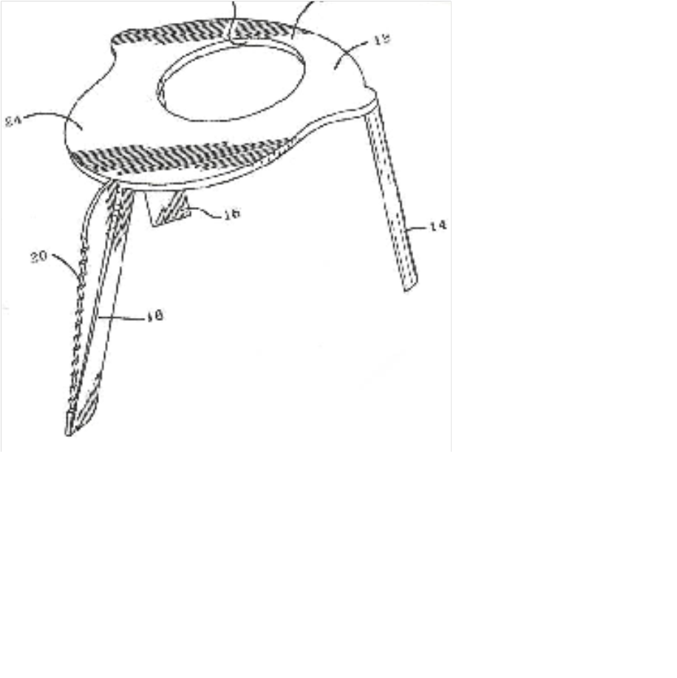
Behold the package saver! (v. 2)

Slide 11
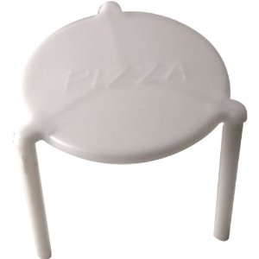
Example -- Patentability
Prior Art (v. 1)
Invention Claim (v. 2)
A lid support comprising:
a platform,
three support legs, and
a serrated edge connected to one of the support legs.
Is the invention patentable over the prior art?

Slide 12
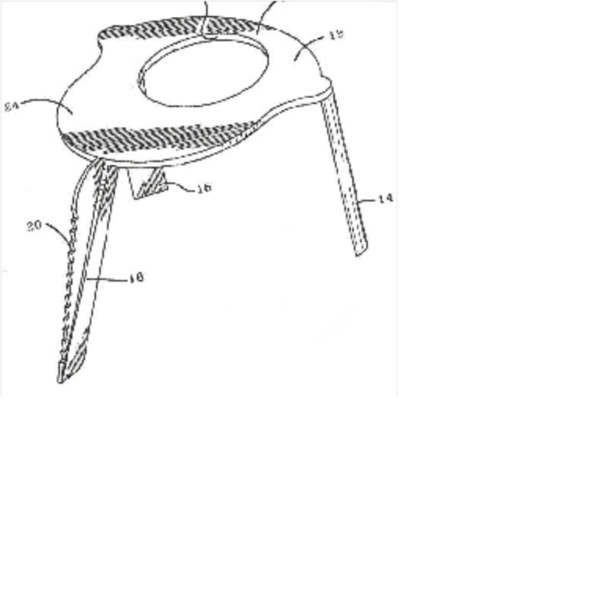
Example -- Infringement
Patent Claim (v. 1)
A package saver comprising:
a platform, and
three support legs.
Product (v. 2)
Can the product be made without risk of infringement?

Slide 13
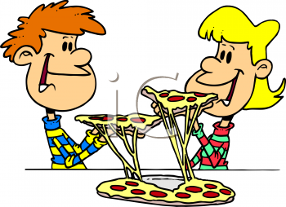
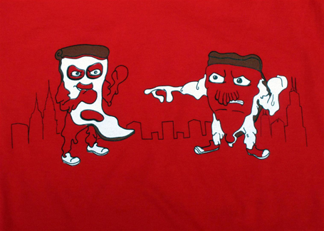
What happens is …
OR
Option 1 – Let’s work together!
  We will both make lots of money on pizza!
Option 2 – Fight it out!
  Our lawyers will make lots of money!
What about the public?
  How long must we suffer?

Slide 14
Conclusion
Inventions can make a lot of dough!
File before disclosing.
Critically evaluate the commercial merit of your invention early.

